Slide 1
Digital Construction Session
Craig C Ferrans MCIAT – HBF Technical Director

Slide 2
Agenda
Introductions
What is BIM (Building Information Modelling)?
House Builders Journey
Supply Chain Support
Deliverables
Benefits of Digital Construction
HBF response
Q&A Session

Slide 3
Housekeeping

Slide 4
Introductions

Slide 5
What is Building Information Modelling?

Slide 6
What is Building Information Modelling?
“An integrated digital process providing coordinated, reliable, shareable data throughout all project phases, from design through construction and into operation”

Slide 7
House Builders Journey
Started the process in 2010
BIM just a buzz word?
Media research
Is there any added value to the business?
Carbon agenda was influential
Improve accuracy
3D Visualisation to assist planning
Collaborate with stakeholders

Slide 8
Fact Finding
Software demonstration
Change in vocabulary
Components fully parametric
Automated scheduling
Work with Worksets
Tap into visualisation
Supply chain involvement
Drive standardisation

Slide 9
IT Hardware and Infrastructure

Slide 10
Taking the Plunge

Slide 11
Getting Started
2011 Software was installed
Only Central Team used Revit
All BIM content was created by Miller homes
Incredibly steep learning curve
Internal service levels maintained
All standard house types drawn in native Revit software
Original working drawing packs replicated

Slide 12
Live Views

Slide 13
Working Drawing Information

Slide 14
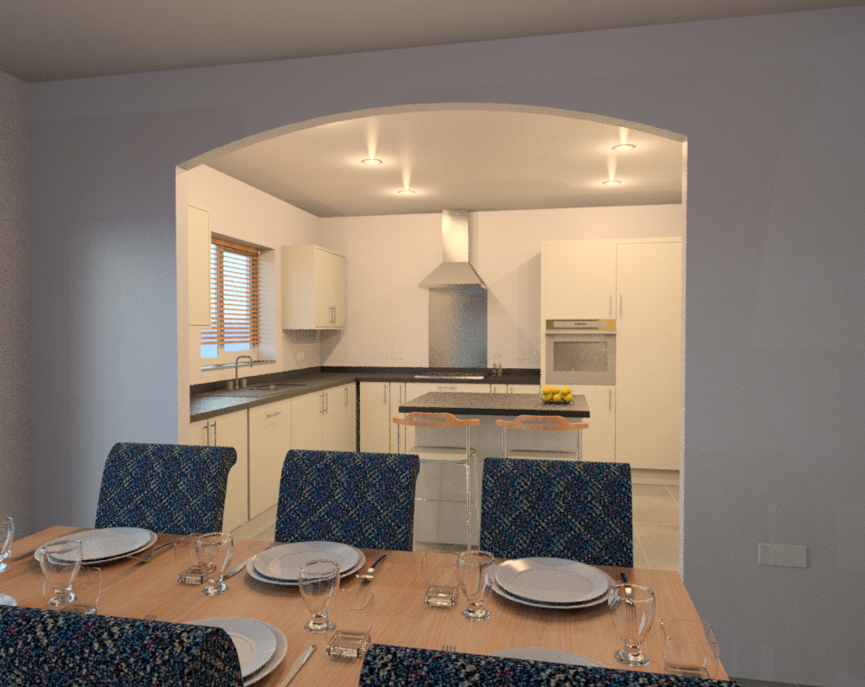
Internal Design

Slide 15
Visualisation

Slide 16
Terminology
Blocks
Family’s

Slide 17
Family Creation

Slide 18
Asset Data Examples
Product details
Maintenance schedules
Contractual & guarantee information
Thermal Details
Travel distances
Installation instructions
Quantities
Costs
Storage
Delivery times
Health and Safety
Recycling & disposal suggestions
URL’s

Slide 19
Schedules

Slide 20
Exporting Information

Slide 21
Tail Chasing

Slide 22
Supply Chain Support

Slide 23
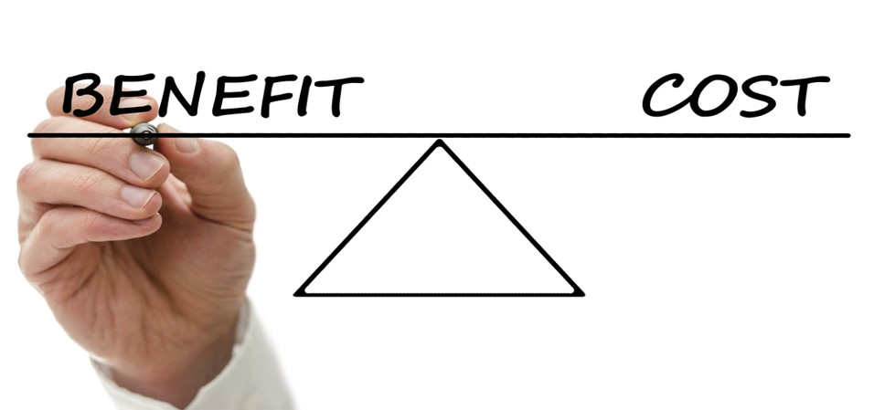
Supply Chain
Contribute in different ways
Provide BIM content
Collaborate directly within the model
Schedule information & drawings

Slide 24
Supply Chain
Potential to align BIM schedules with build programme
Delivery dates & requirements
JIT deliveries?
Better stock management
Focused stock levels
Right product & right time
Visibility of forecasted requirement

Slide 25
Supply Chain
Component & specification schedules
Use in subcontract tenders
Compliance; less interpretation
Consistent and accurate costings
Increased cost knowledge
Improvement in installation quality
Less errors; reduced wastage

Slide 26
Collaboration

Slide 27
Street Scenes

Slide 28
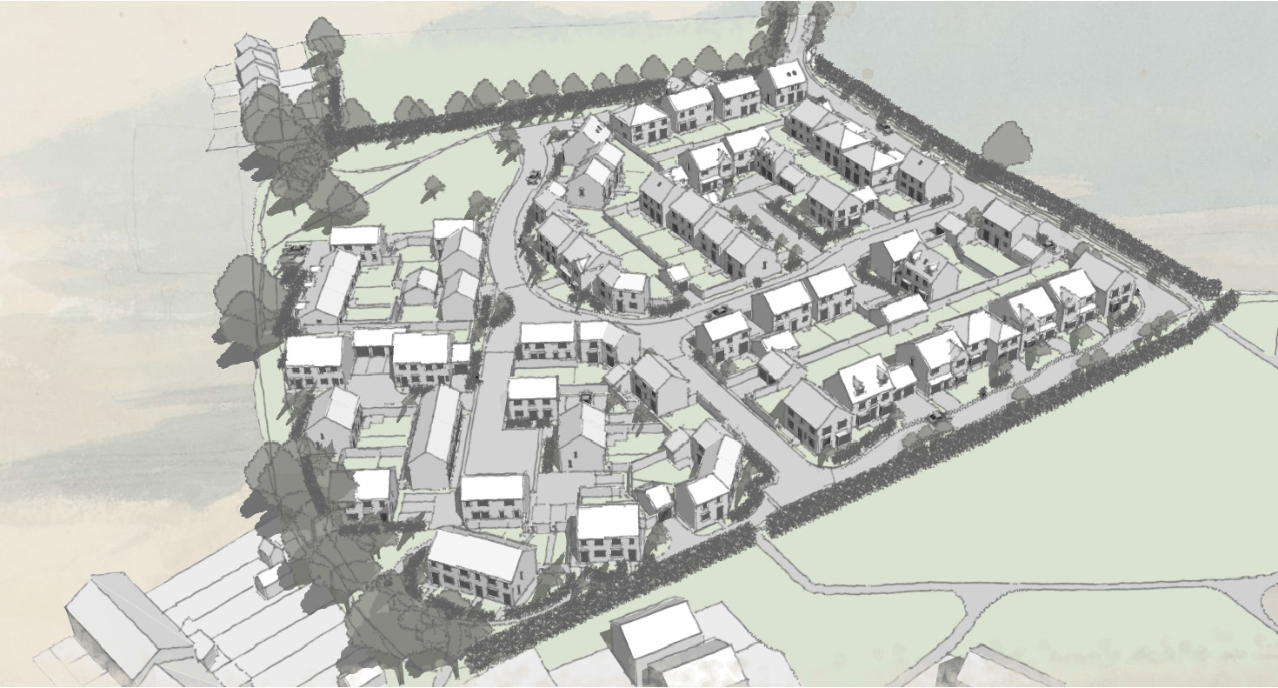
Site Layout Design

Slide 29
Site Layout Design

Slide 30
Solar Studies

Slide 31
Practical Workshop – Draw a House

Slide 32
Practical Workshop – Build a House!

Slide 33
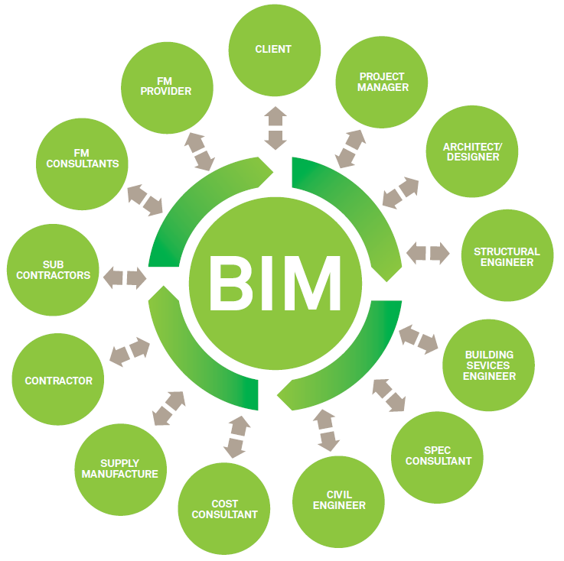
Process Not Just Technology
“BIM is about people and process as much as it is about software”

Slide 34
Silo Mentality

Slide 35
Benefits
Standard process to improve quality and reduce waste
Communicate more effectively to reduce risk and uncertainty
Gain early insight into quality and health & safety
Measure and report on site activities and productivity
Reducing handover issues to improve home owner satisfaction
Provides invaluable data sets and cost analysis
Links with other compliance tools
Supports beyond the sale of the home

Slide 36
Quality and Customer Satisfaction

Slide 37
HBF Digital Construction Group
Promotes Digital Construction
Support network for House Builders
Share best practice
Removes ambiguity
Enhance communication with key stakeholders
Reports back to the wider housebuilding community
Seeks to push boundaries and innovate

Slide 38
Our Role Together
We can…
De-risk all phases of the development process
Greater collaboration
Improve Productivity
Reduce costly errors
Through data identify and address the root cause of issues
Differentiate your company through innovation and quality
Deliver on customer expectations
Digital Construction – the Future!

Slide 39
Perseverance

Slide 40
Q & A Session

